Slide 1
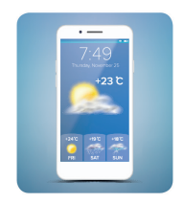
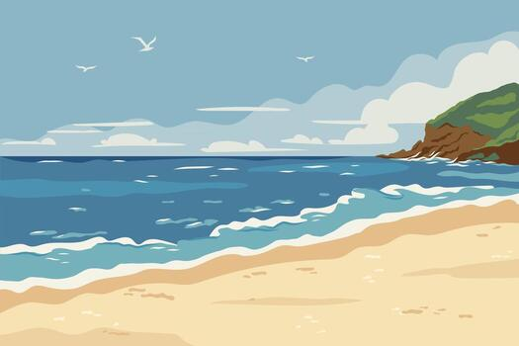
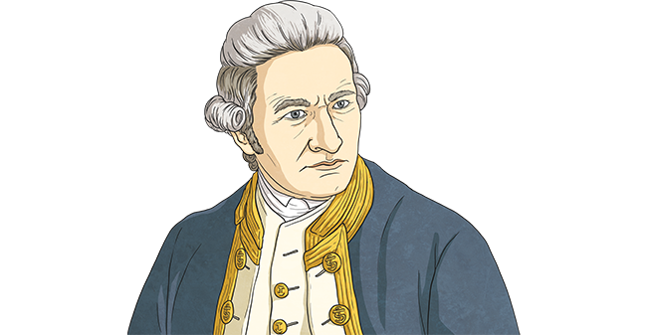
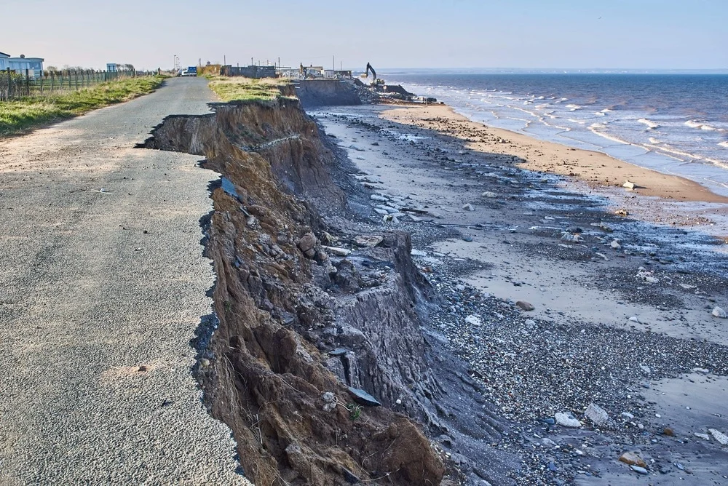

Find out what these words mean: Compass Coastline Capsize Emergency | Write a beach themed acrostic poem! | Create a poster about human and physical features that we have in Rugby. | Keep a weather diary for a week.
Draw a map of Rugby including our school, your house, Lawrence Sherriff School & any other places you can think of. | Please complete these activities over the next half term. They are linked with our upcoming topic “Coastline” You can either showcase these in your homework book or send photos via dojo. |  | Research Captain Cook and create a timeline of events of the important things he did.
Draw a map of the United Kingdom and label them with 4 the countries | Write a definition for the word…. erosion | Name 3 dangers that you need to be aware of when visiting a coastline. | Draw a compass and label it with the 4 compass points.

