Slide 1

Home Learning Meeting
Year 1 2025-2026

Slide 2
Why We Changed Home Learning
Last year, Home Learning often included printed worksheets
01
These were time-consuming and sometimes unenjoyable
02
We wanted to make learning more creative, flexible, and fun!
03
Encourages more family involvement and conversation about learning
04

Slide 3
What is Home Learning?
Each month your child will bring home a Home Learning book
Tasks are linked to:
Reading and phonics
A seasonal or outdoor activity
Topic learning (e.g. history, geography, science)
Maths
You can complete the tasks in your own time—flexibility is key!

Slide 4

Due Dates & Expectations
Home Learning tasks are checked throughout the month
New tasks set monthly
Please ensure all tasks are completed by the end of each month
Books should stay in book bags to be reviewed regularly

Slide 5
Why Home Learning?
Strengthens the link between home and school
Supports class learning in fun and inspiring ways
Gives children space to:
Be creative
Get outdoors
Talk with their families
Celebrate their progress

Slide 6
Filling the Home Learning Book
Pictures of your child completing a task 📸
Comments about what they said or did 💬
Child’s drawings or writing ✏️
Your comments celebrating their progress 🌟
Note: Books should be joyful, not a place for worries—please use Class Dojo or speak with me directly for any concerns.

Slide 7
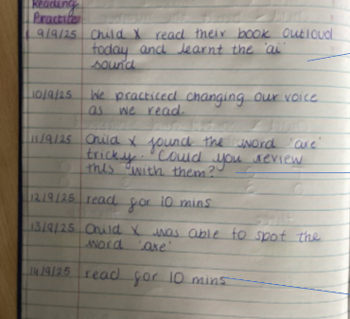
Example 1 – Reading Practice
Comments from parents about progress
Celebrate tricky words
Reading recorded by date and time
Simple, supportive notes work best

Slide 8
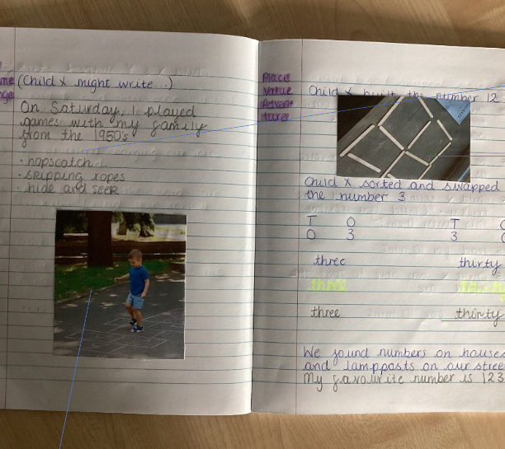
Example 2 – Learning Through Play
A 1950s games challenge!
Photos, child’s writing, parent notes
A real celebration of learning together

Slide 9
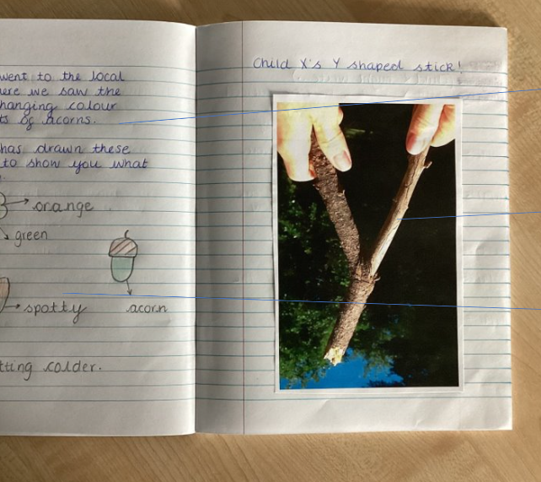
Example 3 – Outdoor Learning
Trip to the park
Child’s drawings and writing
Parent’s note about the experience
A great way to mix learning with fun!

Slide 10
Final Reminders
E
Let your child take the lead!
N
Encourage creativity and talk
G
Keep books in book bags 📚
A
Complete by end of the month
Use Dojo for any concerns or help
E
Let’s make Home Learning a positive, engaging experience that celebrates your child’s learning journey 🌈
G

Slide 11
Any Questions?
Please feel free to ask now, or message me via Class Dojo anytime.

